Slide 1
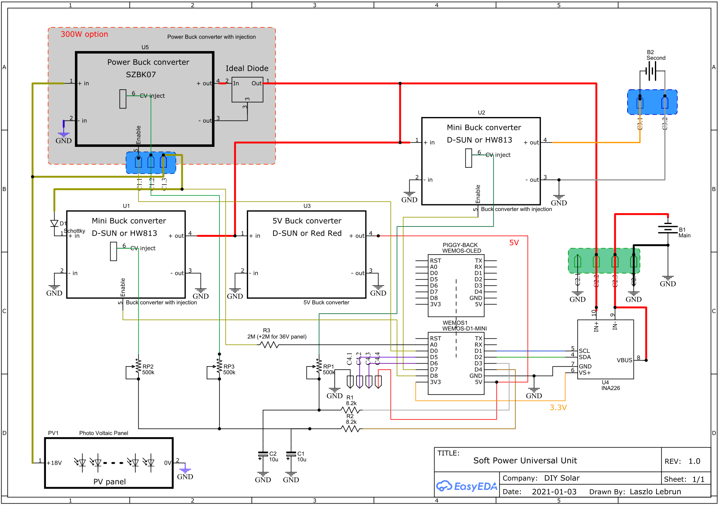

Slide 2
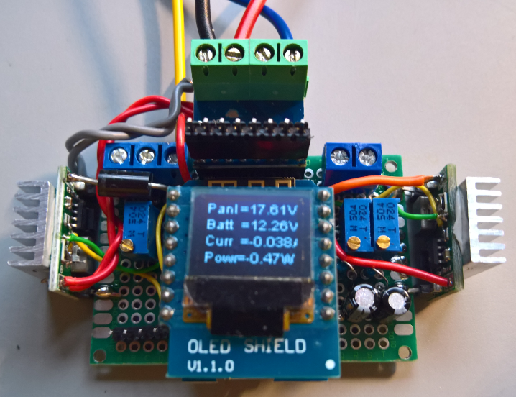
Prototype

Slide 3
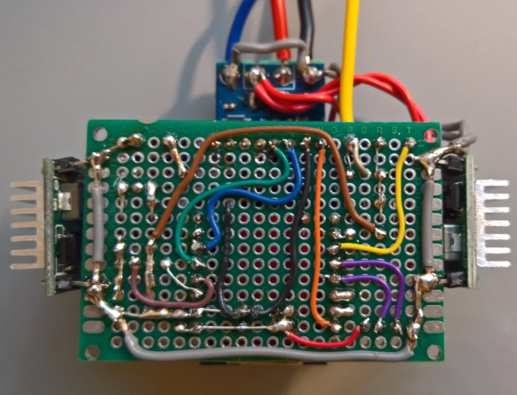
Prototype
Color conventions: Black or Grey: GND, Thin Red: 5V, Thick Red: Battery, Thin Orange: 3,3V, Thick Orange: Convenience output, Thin Yellow: Enable, Thick Yellow: panel Voltage, Brown: PWM ; Blue: I2C SCL, Green: I2C SDA, (on the other side) Lighter Green: CV injection, Violet: Relay Control.

Slide 4
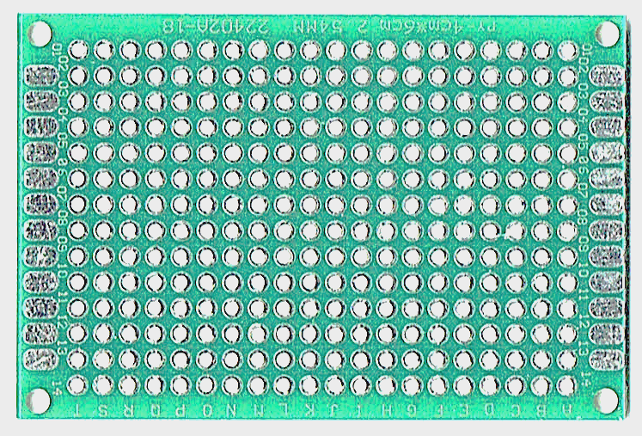
Component Layout <21W
+
INA221
C2
Power Buck En CV Pan
- + B1
+ - Buck out
B2 + -
PV Panel
C1
C5
C3
D1
-
R3
Mini Buck Input
ESP8266
Mini Buck B2/convenience
U1
RP3
RP1
U2
U3 5V Buck
RP2
R1
R2
C2
C1
C4

Slide 5
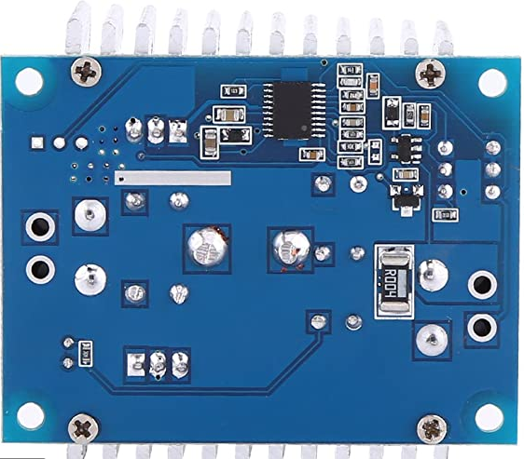
+
Component Layout <300W
Ideal diode - - +in out+
PV Panel
INA221
-
C2
SZBK07
Power Buck En CV Pan
- + B1
+ - Buck out
B2 + -
C1
C5
C3
D1
Mini Buck Input
R3
Mini Buck B2/convenience
U1
ESP8266
RP3
RP1
U2
U3 5V Buck
RP2
R1
R2
C2
C1
C4

Slide 6
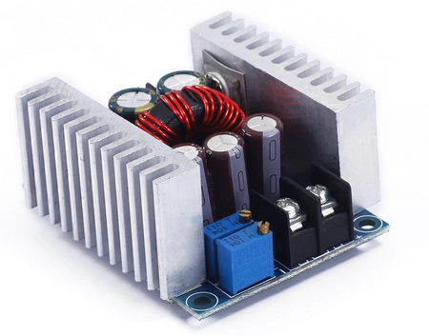
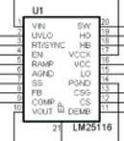
SZBK07 300W 15A 6-40V -> 1.2-36V
LM25116 synchronous chip
FB=1,215V 350Khz progr.
No load current buck converter 40 mA Low load current +MPPT + WiFi 34 mA Efficiency @ 0,5W 45% Efficiency @ 10 W 94% Efficiency @ 25 W 96%
Efficiency @ 75 W 96% Max current 1 A @ 22°C Neutral injection PWM=250
CV injection
Enable
PWM | 6x LeadAcid | 4x LiFePo | 3x LiIon
0 | 14.96
200 | 14.40
320 | 14.00
380 | 13.80 | 13.20 | 12.80
490 | 13.50
640 | 13.00
950 | 12.00
1024 | 11.84
Tested 2A.
Low-pass 6,8KΩ/330nF
Injection 330KΩ

Slide 7
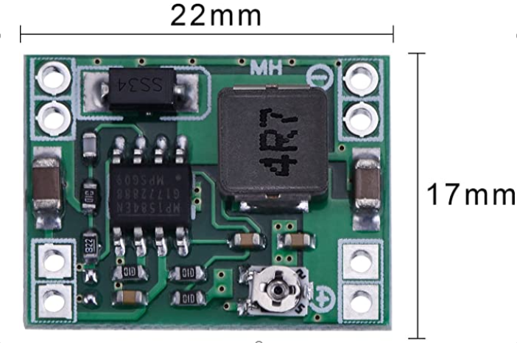
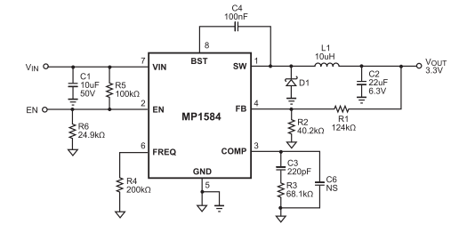
D-SUN 1A 6-40V -> 1.2-36V
MP1584 asynchronous chip
FB=0,8V 350Khz
No load current buck converter 0,1mA Low load current +MPPT + WiFi ~7mA Efficiency @ 0,5W 86% Efficiency @ 10 W 96% Efficiency @ 15 W 94% Max current 1 A @ 22°C Neutral injection PWM=250 Convenience output e.g 8.5-12.6V for 3*LiPo (11.6@230)
Enable injection
CV injection
PWM | 6x LeadAcid | 4x LiFePo | 3x LiIon
0.00 | 14.85 | 14.00 | 13.55
100.00 | 14.40
230.00 | 13.80 | 13.20 | 12.80
290.00 | 13.50
390.00 | 13.00
620.00 | 12.00
834.00 | 11.00
1020.00 | 10.12 | 9.50 | 9.20
Tested max 1,5A.
Low-pass 6,8KΩ/330nF
Injection 82KΩ

Slide 8
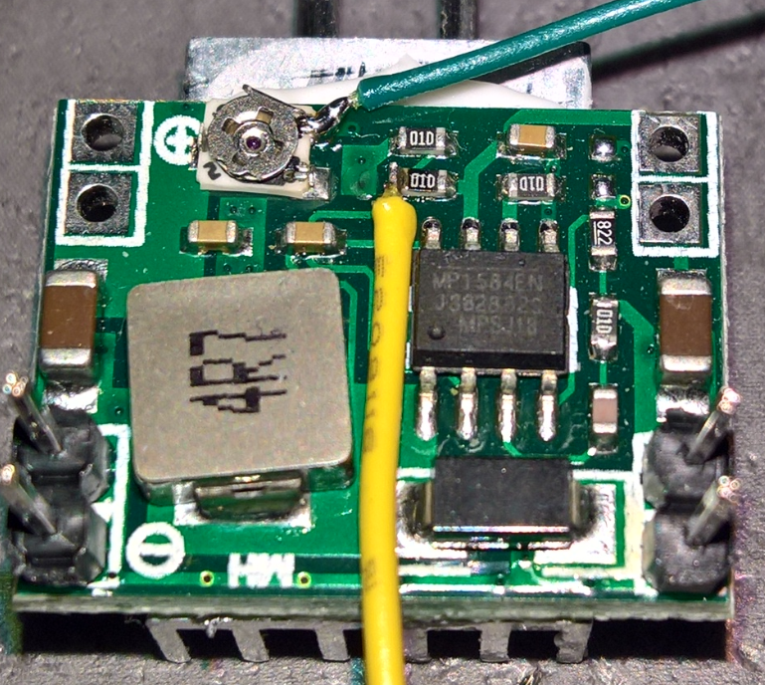
Preparation D-SUN Green wire = CV injection Yellow wire = Enable Heat sink at the bottom Pins soldered at 0V Input / Output

Slide 9
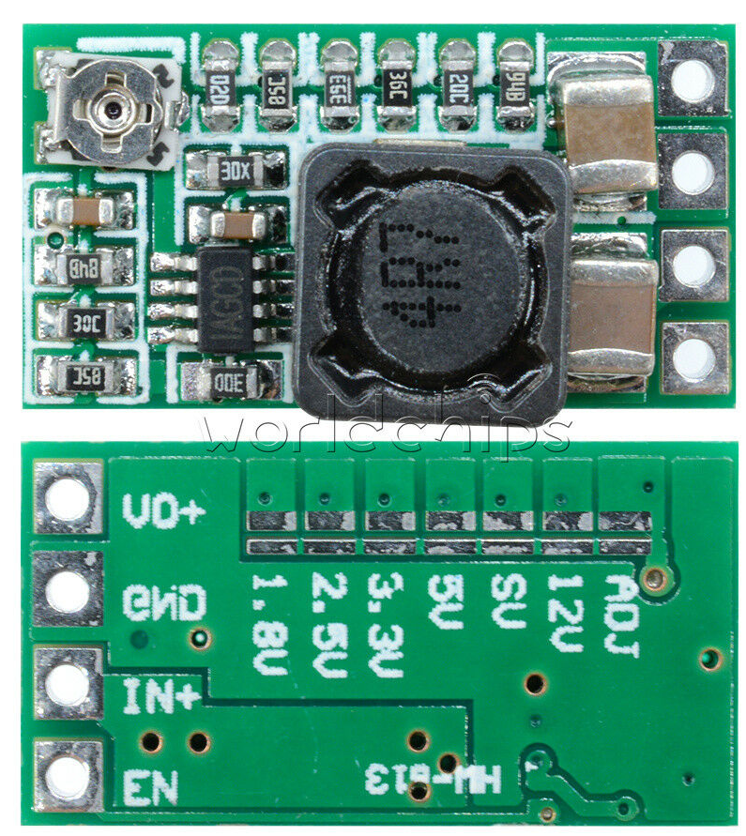
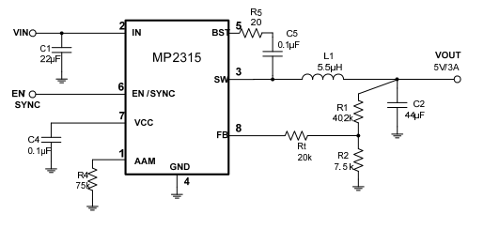
HW813 2A 6-28V -> 1.2-24V
MP2315 synchronous chip
FB=0,79V 500Khz
No load current buck converter 0,1mA Low load current +MPPT + WiFi ~7mA Efficiency @ 0,5W 91% Efficiency @ 15 W 96% Max current 2 A @ 22°C Neutral injection PWM=250
Better board ORDERED !
PWM | 6x LeadAcid | 4x LiFePo | 3x LiIon
0 | 14.96 | 14.20 | 13.85
130 | 14.4
250 | 13.8 | 13.20 | 12.80
320 | 13.5
420 | 13
640 | 12
860 | 11
1024 | 10.21 | 9.76 | 9.50
Tested 2A.
Low-pass 6,8KΩ/330nF
Injection75KΩ

Slide 10
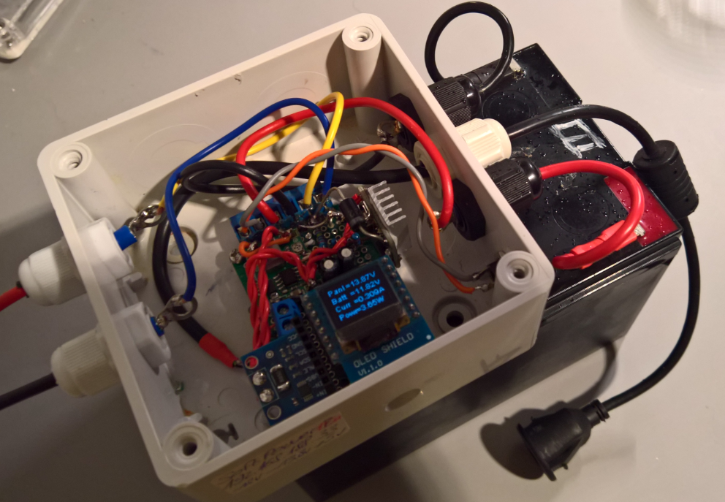
15W V0.1 in IP65Box

Slide 11
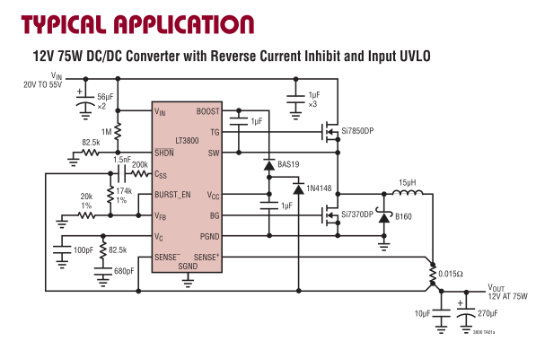
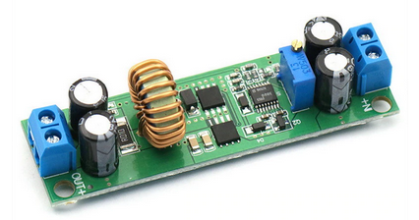
LT3800 400W 10A 6-60V -> 1.2-36V
LT3800 synchronous chip
FB=1,224V 200Khz
No load current buck converter (should be very low) No load current MPPT + WiFi ? Max current >10A @ 22°C to be tested Neutral injection PWM= likely to be 380 (1.224V reference). High side current sensing. Input：6.5V-60V Output: 1.25-30V adjustable Efficiency：97%（MAX） Load capacity: upper limit 10A Size: 75*21*16mm
Higher voltage Board ORDERED !

Slide 12
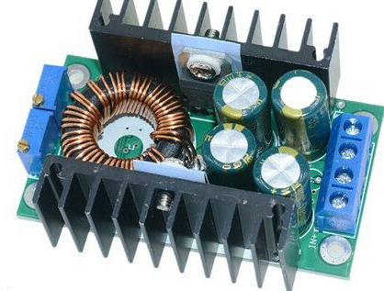
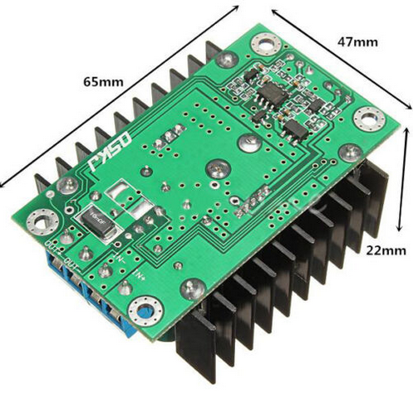
XL4066 250W 8A 6-40V -> 1.2-36V
CV injection
XL4066 asynchronous chip
FB=1,2V 350Khz
No load current buck converter 17mA No load current +MPPT + WiFi ~27mA Max current >5A @ 22°C limit to be tested Neutral injection PWM=380
2nd choice
PWM | 6x LeadAcid | 4x LiFePo | 3x LiIon
0.00 | 15.60 | 14.97 | 14.45
130.00 | 15.00
250.00 | 14.40
330.00 | 14.00
380.00 | 13.80 | 13.2 | 12.8
540.00 | 13.00
760.00 | 12.00
980.00 | 11.00
1024.00 | 10.80 | 10.36 | 10.05
Tested 5A
Low-pass 200Ω/33µF
Injection 2,5KΩ

Slide 13
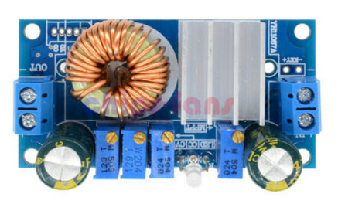
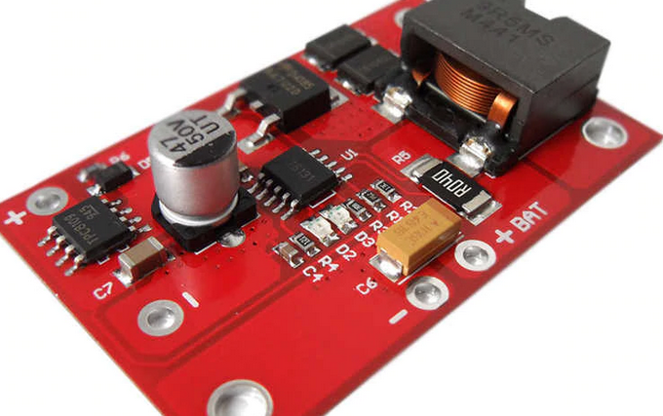
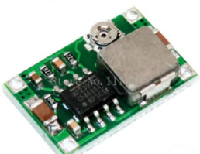
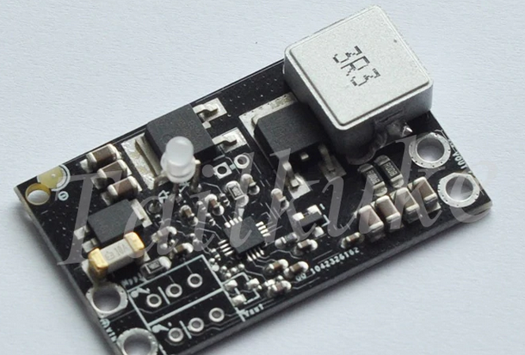
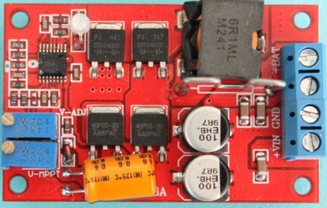
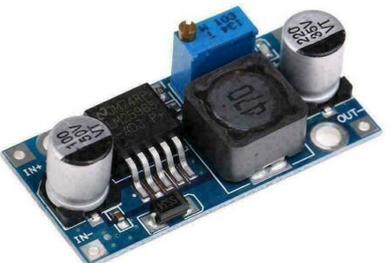
Consonance chips
XL4015 chip
MP23070 Chip
Very high no-load current, High variance, Some modules get hot without load. Seems to be an obsolete failed chip
Too touchy to trim, maybe OK for standalone.
Does not load a lead-acid battery correctly: other similar models specific for LiPo might work Anyhow everything is burnt in silicon and not flexible. enough.
BQ2460 chip
Failed!
Too high no-load current, not worth the price
Too touchy to trim, not worth the price
LM2596 chip
20mA no-load current too high 7mA without LED…

Slide 14
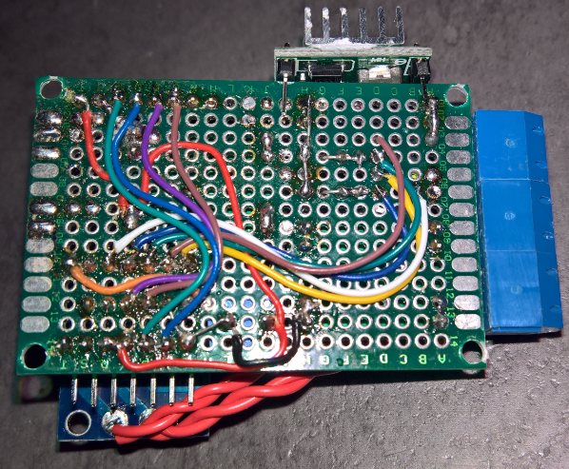
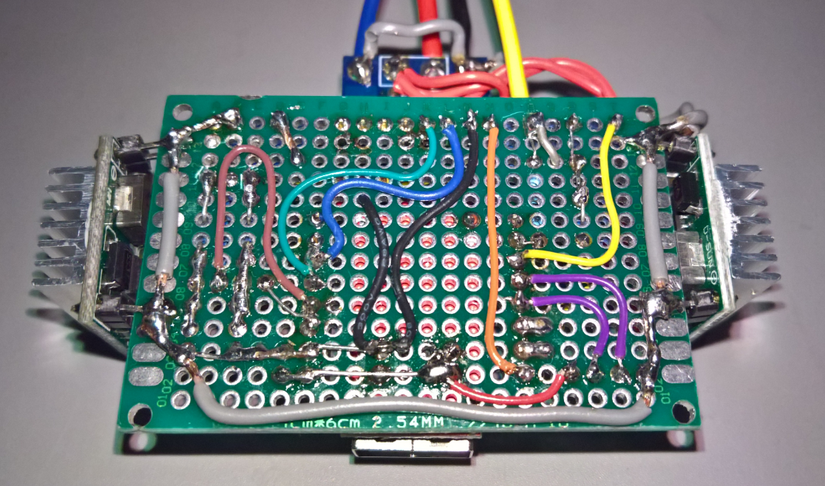
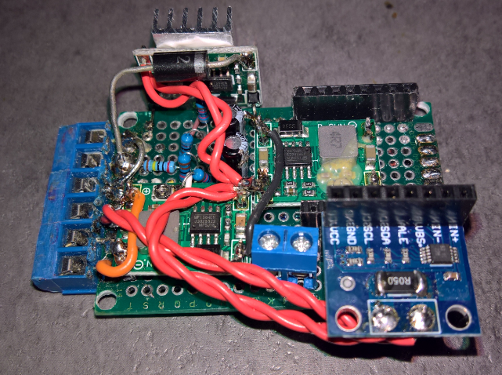
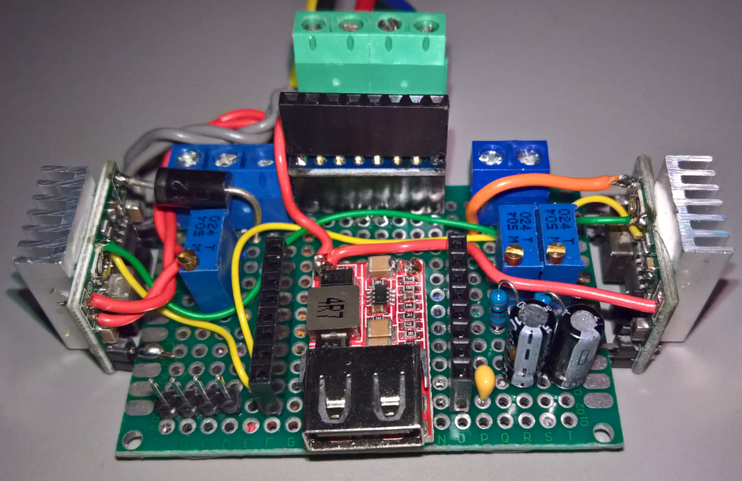
Rearrangement on Prototyping
Old
New

Slide 15
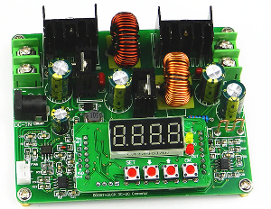
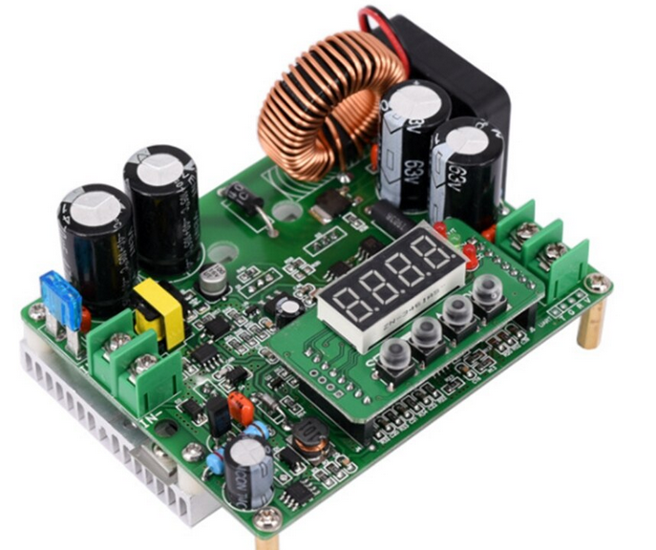
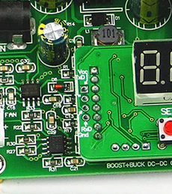
Juntek DPS3806

Slide 16
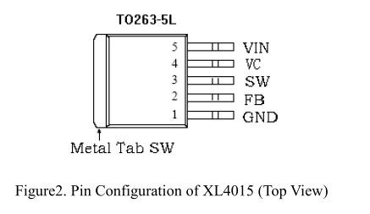
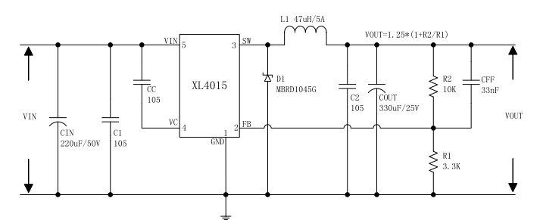
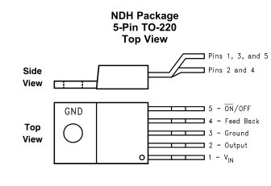
Allows the switching regulator circuit to be shut down using logic signals thus dropping the
total input supply current to approximately 80 µA. Pulling this pin below a threshold voltage
of approximately 1.3 V turns the regulator on, and pulling this pin above 1.3 V (up to a
maximum of 25 V) shuts the regulator down. If this shutdown feature is not required, the
ON/OFF pin can be wired to the ground pin or it can be left open. In either case, the
regulator will be in the ON condition.
LM2596

